Slide 1

Quantum Propulsion via Dank Memes
Presenter Name

Slide 2
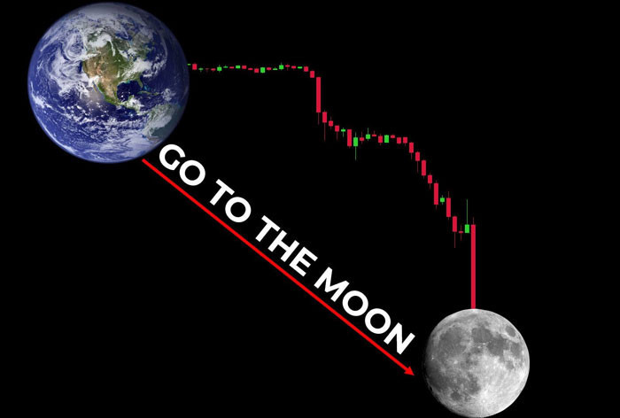


Agenda
Acquire Memes
To the Moon
???
Profit

Slide 3
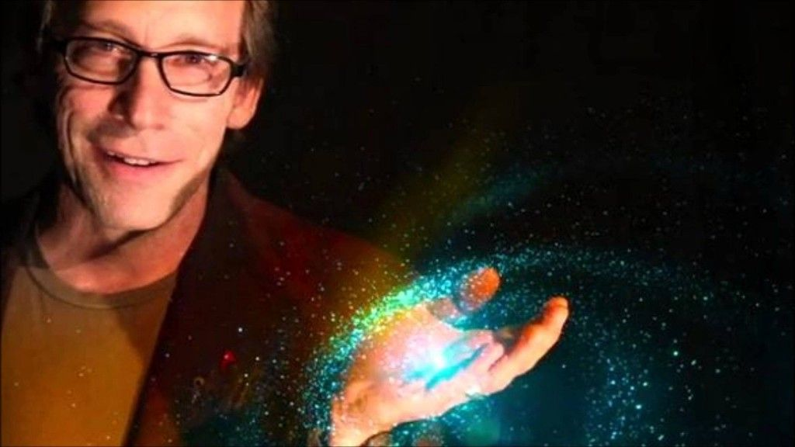



Introduction

Slide 4

Fantastic Memes
And where to find them

Slide 5
Chart

Slide 6

The way to get started is to quit talking and begin doing.
Walt Disney

Slide 7

Timeline
Grandma’s Walker
Classic Memes- Rick Rolls
Snail
Black Bar photo captions
Yeetable Speed
Comic Frame Panels
Zoomin
Mach Jesus
MS Paint Based

Slide 8


Leveraging the Etymology of Zoomer Linguistics for quantum meme acquisition
Wut is Rizz?
Help I am trapped in the simulation

Slide 9

Summary
Dank memes melt steel beams at ludicrous speed

Slide 10


Thanks for nothing
Contact
Email address : 360n0sc0p3Ez@aol.com
https://wordpress.com/g3tg00d/

